Slide 1
CARING FOR UNACCOMPANIED MIGRANT CHILDREN
A training manual for foster carers
BELGIUM
Funded by the European Union

Slide 2
Extra Module|
Culture-sensitive care
Schedule - 8u45-16u30
Time | Activities
8.45 – 9.00 | Registration / Entry
9.00 – 9.10 | Aim and Objectives
9.10 – 9.30 | Activity 1: Introduction to culture-sensitive care
9.30 – 10.15 | Activity 2: Breaking taboos (2.1, 2.2, 2.3)
10.15 – 10.30 | Coffee break
10.30 – 11.20 | Activity 2: Breaking taboos (2.4)
11.20 – 12.55 | Activity 3: Dealing with racism (3.1, 3.2, 3.3 A)
12.55 – 13.35 | Lunch
13.35 – 15.00 | Activity 3: Dealing with racism (3.3 (cont.), 3.4)
15.00 – 15.10 | Coffee break
15.10 – 16.00 | Activity 3: Dealing with racism (3.5, 3.6, 3.7)
16.00 - 16.20 | Activity 4: Space for spirituality and meaningful living
16.20 - 16.30 | Activity 5: Closure and evaluation
.
2

Slide 3
Extra Module
Culture-sensitive care
0. Aims and Objectives
By the end of the training, participants will:
Have gained insight on the topic of sexuality, gender and culture.
Be familiar with taboos in societies as to manage them in their own living environment.
Be able to recognize racism and adequately react to it.
Have gained insights into personal self-care strategies.
3

Slide 4
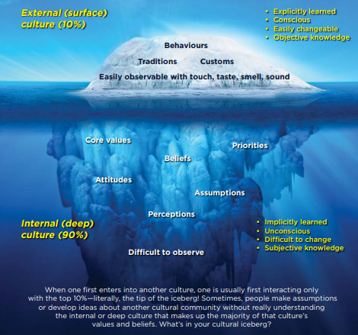
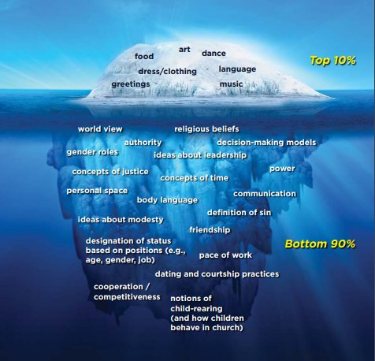
1. Introduction to culture-sensitive care
The Cultural Iceberg
By Edward T. Hall
Source: https://adeaconsmusing.ca/
4

Slide 5
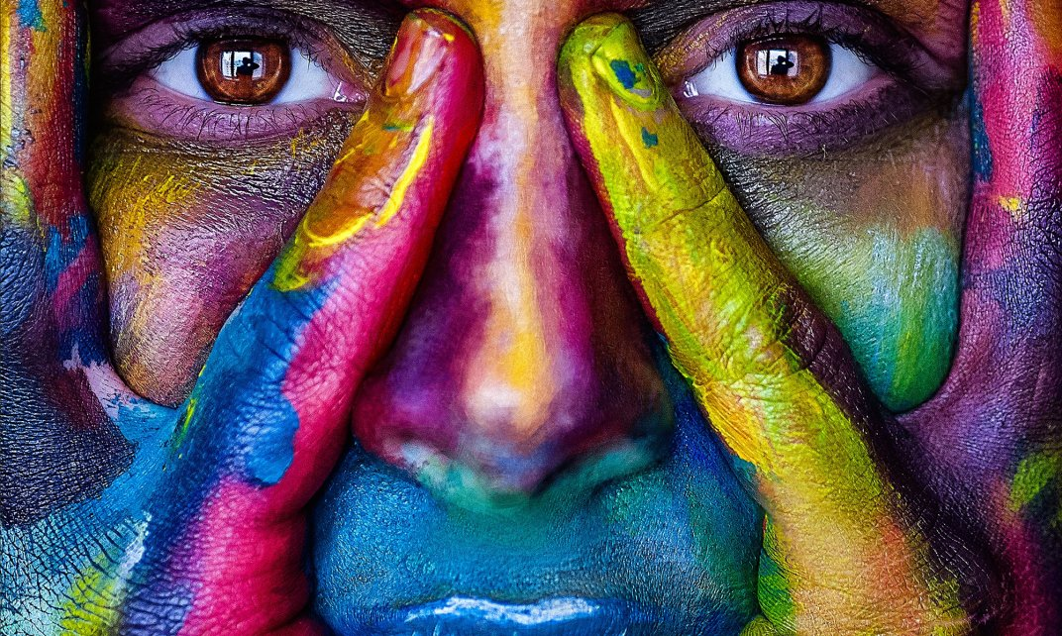
1. Introduction to culture-sensitive care
What is culture?
“The set of distinctive spiritual, material, intellectual and emotional features of a society or a social group encompassing, in addition to art and literature, lifestyles, ways of living together, value systems, traditions and beliefs.” (EMN Asylum and Migration Glossary)
Culture is:
Personal and dynamic (social construct)
Composition of norms, values, meanings, views of a social system to which a person belongs
.
5

Slide 6
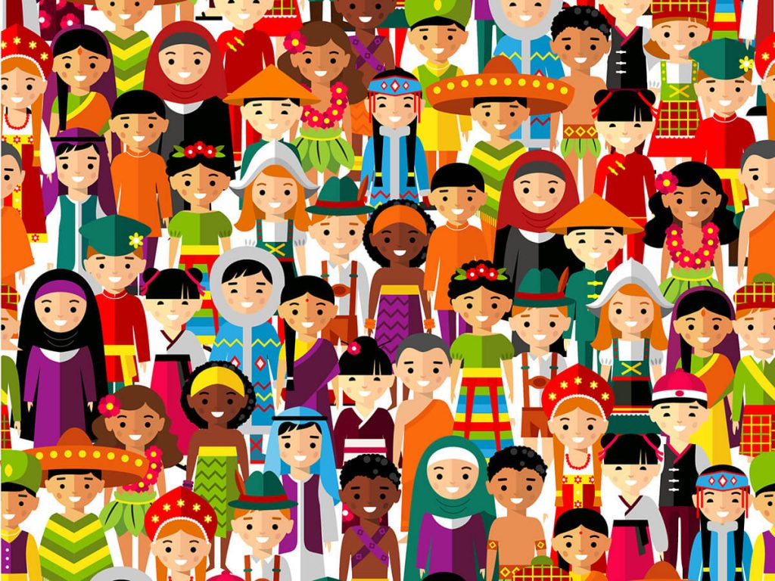
1. Introduction to culture-sensitive care
What is culture?
According to Hofstede, culture is:
The collective programming of the human mind by which one group of people distinguishes itself from another group.
Shared values ​​and norms, expressed in the behavior of members of a group.
Culture is a construct and learned through education & upbringing, socialization, observation and perception
Contrary to nature
.
6

Slide 7
1. Introduction to culture-sensitive care
Culture-sensitive care: definition
In culture-sensitive care, the caregiver:
is conscious about the presence of cultural differences and similarities between people, without making a value judgement (no labels of “better/worse”, “correct/incorrect”, etc.
is conscious about own values and norms, as well as (often invisible) prejudices and judgements within a culture.
respects and accepts the other.
understands that reality depends on one’s own experiences, religion, education, traditions, frames of reference, culture, etc.
will challenge own frames of reference, competences and “western” care relationship.
7

Slide 8
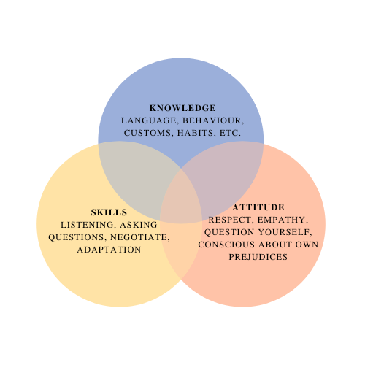
1. Introduction to culture-sensitive care
Culture-sensitive care: definition
Culture-sensitivity is reflected in 3 aspects and is best attained through dialogue:
Knowledge: being open to learn about your own and the others’ culture, language, behaviour, customs and habits
Skills: empathic listening, adapting and asking questions about the experiences of the other
Attitude: lifelong process of being self-critical and self-conscious, taking an intersectional approach, transparency, openness and curiosity
Source: Talloen & Vanmechelen (2018)
8

Slide 9
2. Breaking Taboos
2.1. Introduction
Video: https://www.youtube.com/watch?v=jSsI0LRVpEM&t=1s Marrokiat – Episode 5, courtesy of Jawjab
Sexuality is an example of a taboo and is generally one of the biggest topics of taboo, particularly for newcomers.
Sexuality is sometimes linked to the honor of a family and goes hand-in-hand with power relations. If this honor has been violated, it should be restored, if necessary, by using violence (honor-related violence).
There can be great differences in sexual values and norms, manners, male-female relationships and other gender roles between country of origin and current context.
9

Slide 10
2. Breaking Taboos
2.2. Definitions
Taboo: “A taboo is something that is considered inappropriate to use, do or talk about. Violating a taboo in a particular culture can lead to the violation of honor, social exclusion, stigma, legal or political persecution.” Ex. Prohibition of homosexuality, headscarves ban, legalization of child marriages.
Sexuality: "Sexuality is a central aspect of human life. It includes sex, gender identity and roles, sexual orientation, eroticism, pleasure, intimacy and reproduction. Sexuality is experienced and shaped in thoughts, fantasies, desires, beliefs, attitudes, values, behavior, actions, roles and relationships. Although sexuality can encompass all these dimensions, they are not always experienced or shaped. Sexuality is influenced by the interaction of biological, psychological, social, economic, political, ethical, legal, historical, religious and spiritual factors." (WHO, 2010).
10

Slide 11
2. Breaking Taboos
Gender is the characteristics, traits, talents and (cultural/social) expectations that we assign to individuals. Sex is assigned at birth, but gender is transferred by the society in which you were born.
Stigma is a mark associated with a particular person, group of persons or case. A stigma can also be a negative prejudice that lives among a population group.
Culture is, in the broad sense, all that a society produces and transfers. In concrete terms, this means that culture is what is created by humans and does not happen spontaneously like nature. Culture is a human activity and the symbols that give this activity meaning, ex. marriage, way of eating, language, etc.
11

Slide 12
2. Breaking Taboos
2.3. Exercise on taboos
The importance of following certain dietary regulations and associated motivations
Sexual activities or relationships
Sexual abuse and/or sexual misconduct
Gender diversity, gender expression and sexual orientation
Taboo around religious precepts
Physical or mental illnesses and disabilities
Respect for the hierarchy within families
Other examples of taboos in Western culture include death, euthanasia, suicide and racism
12
Notes:
The importance of following certain dietary regulations and associated motivations (ex. halal/kosher: importance of ritual slaughter; religious regulations on how and when a meal should be prepared and consumed ex. Sabbath).
Sexual activities or relationships: within some cultures, young people are not entitled to information about sexuality; circumcision of men or female genital cutting is a requirement.
Sexual abuse and/or sexual misconduct is not discussed out of fear of stigma and exclusion from the group.
Gender diversity, gender expression and sexual orientation, ex. homosexuality, that is different from the cultural norm is not tolerated in some cultures and is prohibited by law in some countries
Taboo around religious precepts: some worshippers will consider criticism or mockery of their god(s) or religious leader(s) offensive; discussion about covering certain body parts, ex. headscarf or not.
Physical or mental illnesses and disabilities: ex. HIV is attributed in some cultures to witchcraft, a disease of migrants, gay people or linked to prostitution.
Respect for the hierarchy within families ex. older people have a say and cannot be argued against.

Slide 13
2. Breaking Taboos
2.4. How to deal with taboos
Know what you are talking about, inform yourself sufficiently about possible taboos.
Taboos are personal and can vary. Do not generalize.
Persons within the wider network can help to break the taboo. Ex. Involving imam in religious issues.
Dare to ask questions: check how you can enter into a dialogue.
Ask general questions instead of individual or personal questions.
Ask for reasons why some topics are taboo.
Take the time to discuss taboos and schedule multiple moments.
Show empathy and understanding.
Be unbiased, take off your cultural lens.
Know-
ledge
Skills
Attitude
13

Slide 14
2. Breaking Taboos
2.4. How to deal with taboos: exercise
Video: https://www.youtube.com/watch?v=NZtnpAdi_Fw FRAME[D] - Zaïnab Fasiki, courtesy of Jawjab
Family expectations: Yavid is expected to marry an Afghan woman and move out of his brother’s house but is not ready yet.
Sexuality: Fati reacts negatively to the coming out of a member of her foster family.
Mental health: A group conversation in a reception center for UMC on burn-out is not well perceived by (some) UMC.
14

Slide 15
3. Dealing with racism
3.1. Racism against unaccompanied migrant children
Video: https://www.youtube.com/watch?v=-upMeLgy7BI “Filly’s Story”, Unicef Belgium
UMC can experience racism and discrimination:
In country of origin: i.e. ethnic conflict, persecution because of ethnicity/membership of a particular social group, having a diverse SOGIESC, etc.
Throughout the migration journey: border guard/police violence, by local communities, discriminatory legislation, etc.
In country of destination: xenophobia, social exclusion, limited resources/efforts for integration
On a daily basis, as shown by research: in social services, schools, etc.
15

Slide 16
3. Dealing with racism
3.1. Negative effects of racism against UMC
Daily stressors: feelings of powerlessness, can reinforce traumas/injuries of UMC
Negative self-image: need to prove themselves can be frustrating and stressful
Internalized feeling of inferiority
Acting according to negative prejudices
Performing less at school/work: jeopardizing future
Decrease resilience and other coping mechanism
Impact on physical and mental health (depression, trauma, anger, etc.)
16

Slide 17
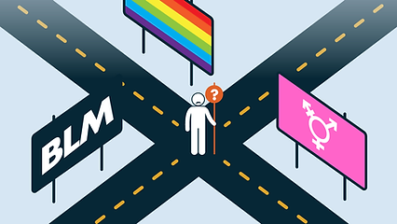
3. Dealing with racism
3.2. Recognizing racism
Metaphor of a dangerous crossroads
17

Slide 18
3. Dealing with racism
3.2. Recognizing racism
Racism competence: a specific set of competencies that everyone needs in a society that struggles with racism
Competencies: understanding differences between people, knowing what racism is in all its versatility, being able to recognize it when it occurs, and being somewhat prepared to deal with it.
18

Slide 19
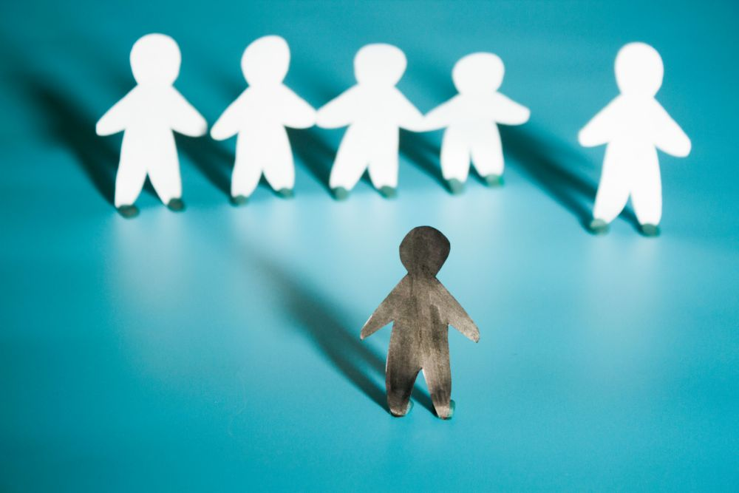
3. Dealing with racism
3.2. Recognizing racism: definition
Racism is an attitude of systematic hostility or contempt for certain persons or groups of persons based on their nationality, skin color, ancestry, national or ethnic origin
Definition used by Naima Charkaoui in her book: “Racism is always about categorizing people based on their origin, supposedly racial physical characteristics or religious beliefs, and this within a social power relationship.”
19

Slide 20
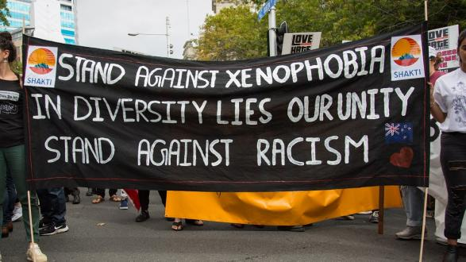
3. Dealing with racism
3.2. Recognizing racism: origins
Negative experiences/ lack of experience
Environment (hometown, family, friends...)
Education/upbringing
Xenophobia
Political context of structural discrimination
Image of non-white people in education and social media from white perspective
Eurocentric culture (novels, movies, art, statues...)
People in authority
History (migration, colonization, slavery...)
20

Slide 21
3. Dealing with racism
3.2. A. Prejudices and privileges
From a young age, people are taught to categorize people. Without being very conscious about it, we put people in boxes based on taught differences between men and women, age, skin color or religion.
Video: https://www.youtube.com/watch?v=IzEdSdvFLU0 “Prejudices”, Anne Frank House
21

Slide 22
3. Dealing with racism
3.2. A. Prejudices and privileges
Privilege = often unearned advantage an individual has in society because of one or more aspects of the individual's identity. It is restrictive, oppressive and benefits one group.
Privileges are typically institutionally embedded and lead to an unequal distribution and access to power and resources.
White privilege refers to the advantage white people have because of their skin color. A white skin color is seen as the norm within our society.
Non-white people often experience barriers because of their skin color. They can become victim of violence, racism and discrimination.
22

Slide 23
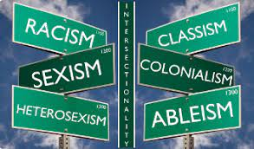
3. Dealing with racism
3.2. B. Intersectionality
Concept introduced by law professor and civil rights advocate Kimberlé Crenshaw in 1989.
Sociological conceptual framework that explains how social categories or aspects of our identity interact and overlap on multiple levels; framework for fighting against oppression and exclusion.
Interconnectedness of social categories: oppressions do not only add up, they merge and create new challenges.
UMC, like everyone, has a multiple identity, but can experience discrimination because of their “sub-identities” (linked to gender, religion, social capital/status, etc.).
23

Slide 24
3. Dealing with racism
3.2. C. Micro-aggressions and -injuries
Small, everyday hurtful experiences.
Often perpetuate negative stereotypes.
“Aggression” is about intentional violence, perceived as harmful and offensive.
“Injuries”, more so than 'aggression', put the victim's experiences at the center of the problem, remarks/questions that are often unintentional.
24

Slide 25
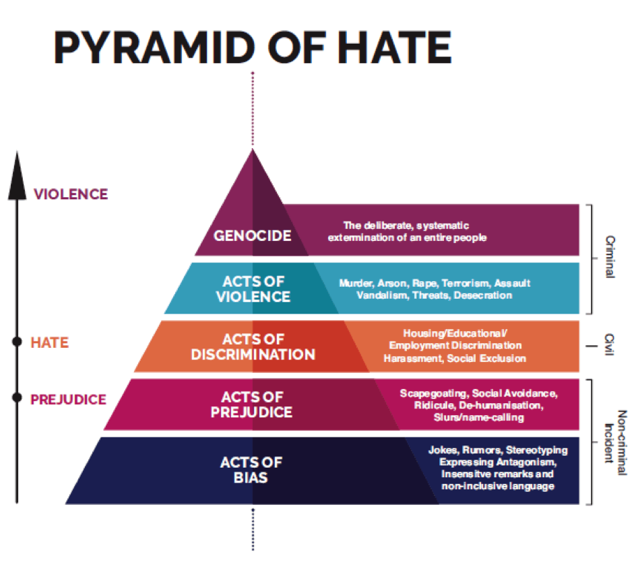
3. Dealing with racism
3.2 D. The Hate Pyramid
Bias: Stereotyping by having a generalized judgment about a group of people.
Prejudice: A biased belief or opinion about a particular person belonging to a particular group.
Discrimination: Treating people differently because of the perceived/real belief that they belong to a particular group.
Hatred can grow into violence and, in more extreme forms, into genocide.
In many EU countries: discrimination and hate crimes forbidden and punishable under the law.
Source: Transforming hate in youth settings (2018), National Youth Council of Ireland (NYCI)
25

Slide 26
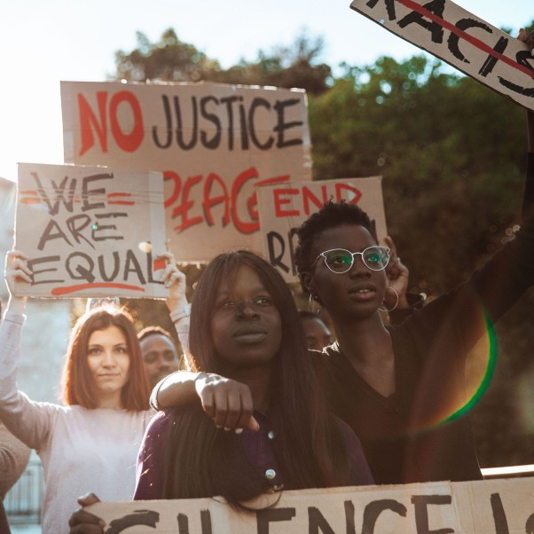
3. Dealing with racism
3.3. Reacting to racism: introduction
• Prevention: increasing resilience
• In-situ resilience: reacting when racism occurs
• Self-care after racism
• Strategies with good intentions, but with more drawbacks than benefits
26

Slide 27
3. Dealing with racism
3.3. Reacting to racism: practical exercise
You will be divided in groups/break-out rooms to discuss a case of racism.
Allocate 1 rapporteur​. For example, nominate the person in the group who has lived in the most countries​.
Every group will get 20 minutes to discuss a case study with guiding questions.
The trainers will move around the groups to guide the discussion and introduce guiding questions​.
After 20 minutes, we will return to the plenary session where each rapporteur will have 5 minutes for debriefing and group discussion.
27

Slide 28
3. Dealing with racism
3.3. Reacting to racism: practical exercise
Ali, a 14-year-old boy from Afghanistan gets bullied at school.
Foster child Pierre from Guinee goes to a fun fair and gets harassed by youngsters.
A resident UMC gets attacked on his way back from language class.
28

Slide 29
3. Dealing with racism
3.3. Reacting to racism: statement exercise
“Which side are you on?” - Objectives and rules:
Foster self-awareness of your role as members of society.
Share thoughts and opinions with each other.
10 statements linked to racism and discrimination while caring for UMC.
Choose a side: walk to the “agree” side or walk to the “do not agree” side → feel free to explain why.
Safe space to go in dialogue.
29

Slide 30
3. Dealing with racism
3.3. Reacting to racism: statement exercise
Statement 1: “When I or my foster child are confronted with racism, I prefer not to talk about it.”
Statement 2: “I find it difficult when my (foster) child turns out to be a victim of racism. I then motivate him/her to do his/her best, to prove others wrong.”
Statement 3: “I see two people acting aggressively towards a black boy. I think it’s a good approach to ignore the aggressor and ask the black boy directly if he can help me with a (non-existent) problem I'm having with my cell phone.”
Statement 4: “Registering my (foster) child in a sports club is a good way to make my child more resilient to future racist experiences.”
Statement 5: “Everyone has prejudices, but that doesn't make them racist.”
30

Slide 31
3. Dealing with racism
3.3. Reacting to racism: statement exercise
Statement 6: “The way I react to racism as a parent is actually not how I want my (foster) child to react to racism.”
Statement 7: “I do not file a complaint against racism and discrimination, because it makes no sense.”
Statement 8: “My (foster) child has been a victim of racism at school. After listening to him, I immediately call the parents of the child who aggressed him and yell at them.”
Statement 9: “I think it is important that my (foster) child has positive role models, who themselves also have a migration background.”
Statement 10: “My foster child decides to take distance of her cultural habits, she doesn’t want to go to the mosque anymore or speak her language in public. I decide to force her to continue with it.”
31

Slide 32
3. Dealing with racism
3.4. Reacting to racism: Prevention – building resilience
• Resilience is the power to successfully deal with stress and adversity.
• Resilience provides a buffer against the negative impact of racism on a person, on their well-being and their future prospects.
• Building resilience is part of a person’s development, especially linked to childhood and adolescence.
• Resilience makes the wound that racism strikes less deep.
32

Slide 33
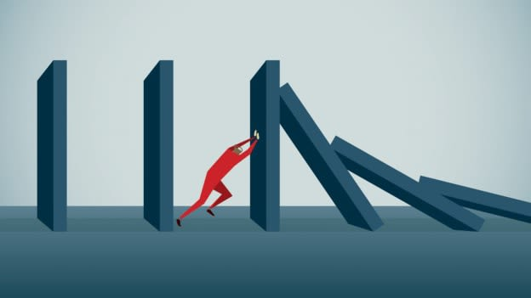
3. Dealing with racism
3.4. Reacting to racism: Prevention – building resilience
Resilience is:
respecting yourself;
daring to express your own opinion;
taking others into account;
being able to say ‘no’;
being able to control yourself;
being able to deal with peer pressure;
being able to recognize and name your own feelings;
being able to recognize and indicate your own limits;
being able to adopt a self-assured body posture;
being able to feel self-confident;
being able to rely on yourself;
being able to ask for and give help when necessary.
33

Slide 34
3. Dealing with racism
3.4. Reacting to racism: Prevention – building resilience
Having a supportive environment
• A strong relationship with (foster) parents, a relationship of trust and positive overall development.
• Good and open communication in a positive (family) climate.
• Create safe networks where UMC do not experience racism and can talk freely.
• Support from broad network of foster care supervisors, teachers, youth leaders, peers, etc.
• Participate in fun leisure activities with peers.
34

Slide 35
3. Dealing with racism
3.4. Reacting to racism: Prevention – building resilience
Developing a positive identity
• Positive identity limits the impact of racism.
• Believe in the UMC as a source of resilience.
• Positive affirmation of the UMC’s cultural baggage (solid ethnic identity).
• Developing a positive identity can be done through music, religion, language, history.
• Developing a positive identity is a continuous process.
• Create a safe space to discuss racism and discrimination: with a supportive network and positive identity it is easier to join white groups.
• Connect your foster child with positive role models and encourage a positive ethnic identity.
35

Slide 36
Identity
3. Dealing with racism
3.4. Reacting to racism: Prevention – building resilience
Definition of identity
1. Who I am, according to myself.
Interiorized social factors: gender, sexuality, culture, race, nation, age, class and occupation, traditions and traditional roles.
3. How others perceive me.
Identity is multifaceted: individuals are composed of different selves (family self, professional self, etc.).
The three components have different “weights” in different communities.
Identity is in continuous evolution: dynamic process of negotiation (internal & external).
Migration and forced migration in particular destabilize the construct of identity.

Slide 37
3. Dealing with racism
3.4. Reacting to racism: Prevention – building resilience
Recognizing and naming racism
• Not only victims, but everyone needs ‘racism knowledge’: everyone needs to learn to recognize all forms of racism and not just the tip of the iceberg (see 3.2).
• Naming gives control.
• Color-blindness does not exist.
• A balanced view on society is important: do not underestimate nor overestimate racism.
37

Slide 38
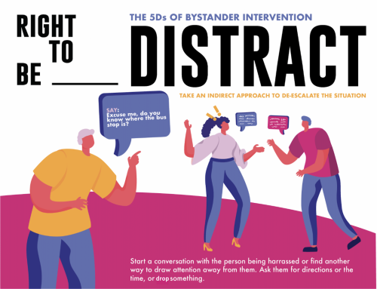
3. Dealing with racism
3.5. Reacting to racism: In-situ coping
5D’s Bystander Strategy
Get away: As a victim, try to get away from the situation; leaving is not defeat. Safety first!
Direct confrontations: address the aggressor, then focus on the victim.
Distract/distraction maneuver: ignore the aggressor and come in between.
Delegate: reach out for help from a third party.
Delay: speak to the victim after the incident to show your support or provide help.
Document: Indicate to the victim that you are willing to testify.
38

Slide 39
3. Dealing with racism
3.5. Reacting to racism: In-situ coping
Hate speech
No recognized definition of hate speech in international human rights (use Council of Europe definition, The 2020 UN Strategy and Plan of Action on Hate Speech).
Tips when confronted with hate speech online or offline:
Refute the hate message: argue why the hate message is not right. Provide facts.
Alternative: find a positive alternative to the hate message.
Dialogue: engage with the person to understand the motivation, focus on the content of the statement.
Ignore: ignore the hater and his/her/their message, definitely if message intends to provoke.
Setting boundaries: indicate that you do not agree with the message and that it is inappropriate.
Report: if the hate messages are online, steps can be taken to report them.
“Allies Strategy” of Orbit vzw: focus on “undertone” of racist message.
39

Slide 40
3. Dealing with racism
3.5. Reacting to racism: In-situ coping
Connective communication
Observing (instead of interpreting): name the behavior, not the intention.
Focusing on emotions (instead of pseudo-emotions): share how this behavior makes you feel.
Expressing your needs (instead of their obligations): “I need acknowledgement” instead of “you have to acknowledge me”.
Formulate a request (instead of a demand): tell them what you would like them to say/do “If you say or do this, it will do the following to me. I would like to ask you to …”
40

Slide 41
3. Dealing with racism
3.6. Reacting to racism: After-(self)care
Never minimize, as this could lead to additional injuries.
First and foremost, listen with empathy.
Let them talk about what happened in private or in a safe space.
People who experience racism often underestimate how often they are confronted with racism. Still, they are a better judge on whether an experience/attack is racist than white people.
If you, as a bystander, believe that a particular situation was not a case of racism, the chances are still very high that the person experienced racism before.
After the experience, analyze the situation: What happened exactly, and why?; How did I react (as a victim or bystander)? How would I like to react next time? When a victim is still highly emotional, it might not be the best time to analyze.
41

Slide 42
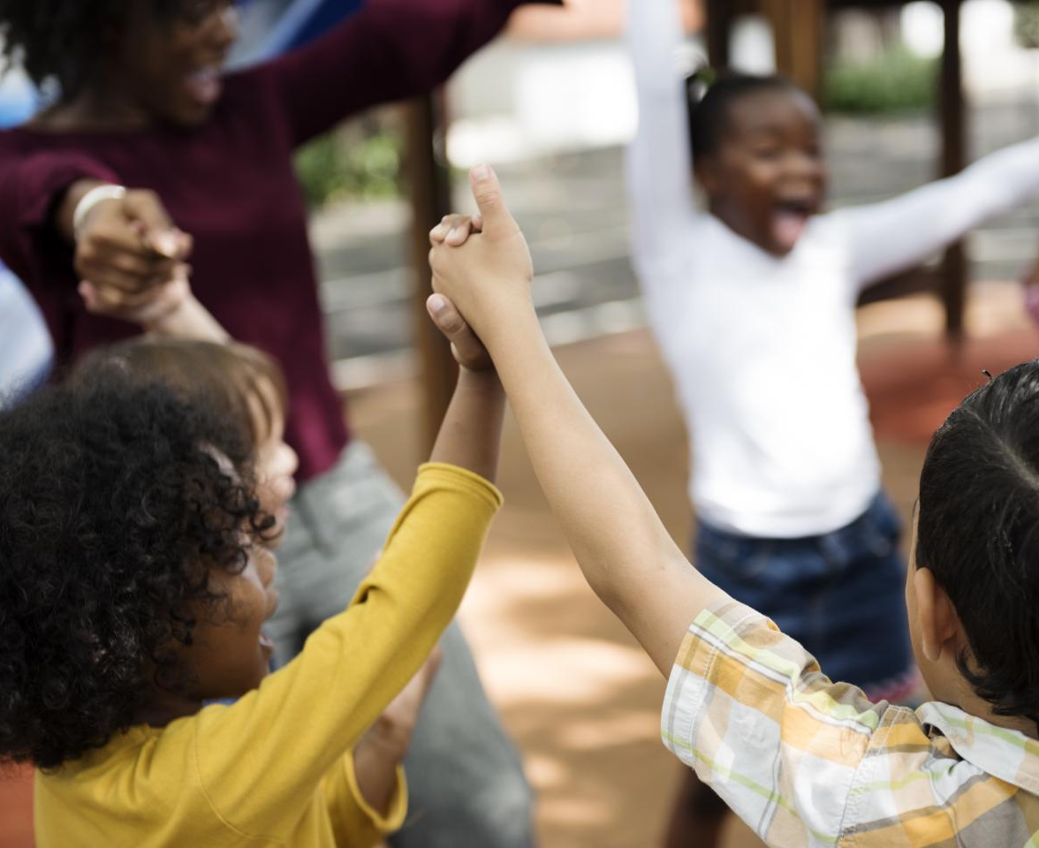
3. Dealing with racism
3.6. Reacting to racism: After- (self)care
• “Talking about it equals healing”: the power of being able to share one’s story/experience freely and safely. It will help to gain understanding regarding the act, injuries and methods of reacting, as well as to gain back control.
• Give and receive support: the victim should get all the attention; their needs should be checked. Bystanders, friends, family or other people from the social network should show empathy and give support.
• Stress management: racism can cause peaks of stress, but also chronic stress (constant fear, heightened state of alert); incorporate moments of rest and relaxation.
42

Slide 43
3. Dealing with racism
3.6. Reacting to racism: After- (self)care
• Development of psychological issues - destructive behavior, posing a risk for the physical health, i.e. suicide, anorexia.
• There is a huge lack of specialized help for victims (“diversity-proof”).
• There is often a taboo regarding seeking psychological help.
• Sharing experiences with peers/other victims of racism can be effective in the trauma processing (i.e. self-help groups).
• Stimulate a healthy lifestyle, keeping an eye on detrimental reactions (i.e. anorexia).
• PTSD: support through more specialized racial trauma therapy can provide support (EMDR, CBT).
43

Slide 44
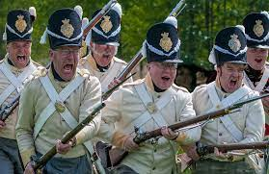
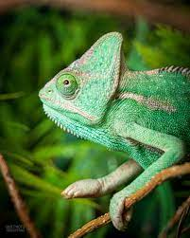
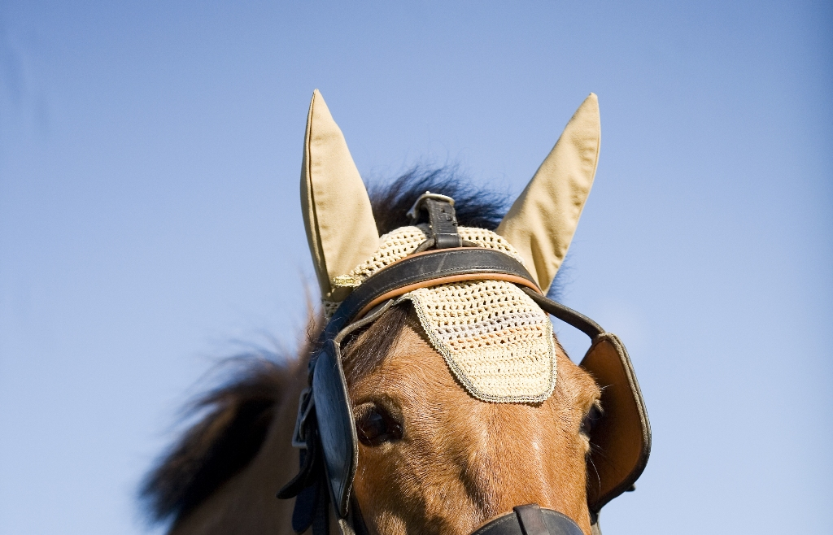
3. Dealing with racism
3.7. Reacting to racism: More harm than good
Strategies to cope with racism
4 strategies that have good intentions with regards to dealing with racism, but often do more harm than good.
4 metaphors to indicate these strategies:
Having blinders on:
“Just ignore them.”
Going into overdrive:
“If you work hard enough, racism will diminish.”
Go on the offense:
“Don't let them do it to you! Fight back and it will go away.”
The chameleon:
"Make sure you don't stand out.”
44

Slide 45
3. Dealing with racism
Important to address hateful behavior or speech. If not, you make hate possible.
To tell about the racist experience is to recover.
Seek professional psychological help if necessary.
Each experience needs a different approach. Sometimes comfort and understanding is sufficient, in other cases there is a need for legal action or psychological help.
You cannot develop a positive identity and healthy self-image alone. The support of friends, counselors, community, school and professionals (= a supportive social network) is crucial in the healing process.
Encourage child to take part in activities they enjoy to build confidence and friendships.
Create an open, safe space to talk about racism and practice active listening.
Model respectful behavior: celebrate diversity and stay calm even when confronted with racism.
3.7. Reacting to racism: More harm than good
45

Slide 46
4. Room for spirituality and meaningful living
Meaningful living/meaningfulness is not always related to something spiritual or religious.
Spiritual self-care is about looking for alternatives or ways to take care of yourself. E.g.: meditating, Yoga, walking in nature.
You can also find meaning in your (family) culture, for example in traditions or cultural food, clothing, etc.
Each of us carries a backpack with experiences: conscious and unconscious memories from which we can draw strength.
46

Slide 47
4. Room for spirituality and meaningful living
Know and recognize your own backpack to be able to carry it with you throughout your life: Self-care!
Find support within your own family or culture: this occurs in almost all families.
Offers guidance and security.
Communicate with family to enjoy their support
E.g.: food from your own country, reading poetry (in your own language), making music, etc.
47

Slide 48
5. Closure and evaluation
Thank you for your participation!
Optional: long info video U-CARE
48

